Slide 1
FPGA-Based Sleep Apnea Detection System
Presented By:
Alexander Osei-Bonsu
Rumali Siddiqua
Mehedi Hasan

Slide 2
Why?
Motivation and Goals:
Sleep apnea is a common sleep disorder causing breathing interruptions, leading to severe health risks.
To bridge the gap between accuracy and accessibility, this project proposes a hardware-based solution designed for real-time feedback.
Utilizes key EEG signal features and a Linear Support Vector Machine (LSVM) classifier.
Achieve high sensitivity, specificity, and overall accuracy in detecting sleep apnea events using robust EEG signal features and machine learning techniques.
Achieve latency reduction to enable real-time processing of EEG signals for immediate detection and feedback.
Minimize the utilization of FPGA resources (e.g., LUTs, slice registers, DSPs) while maintaining performance to allow cost-effective implementations.

Slide 3
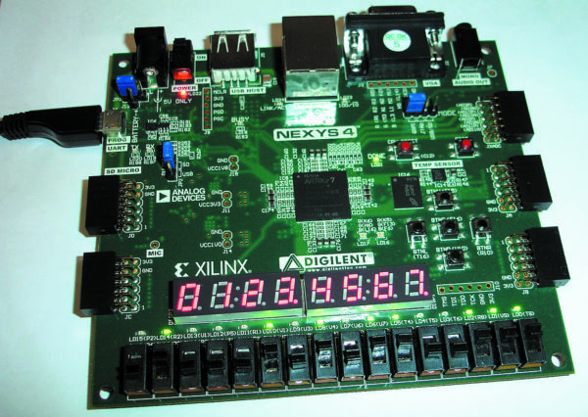
Technology Stack:
Hardware: NEXYS 4 Equipped with Xilinx Artix-7 FPGA
Logic Resources: 15,850 logic slices.
Each slice contains four 6-input LUTs and eight flip-flops.
Over 500 KB of block RAM
100 MHz on-board clock for performance.
16 switches, 16 LEDs, and a 7-segment display
Software Tools: MATLAB, Xilinx Vivado Design Suite
Classifier: Linear Support Vector Machine (LSVM)
Data Source: St. Vincent’s UCDDB PhysioNet EEG
database

Slide 4
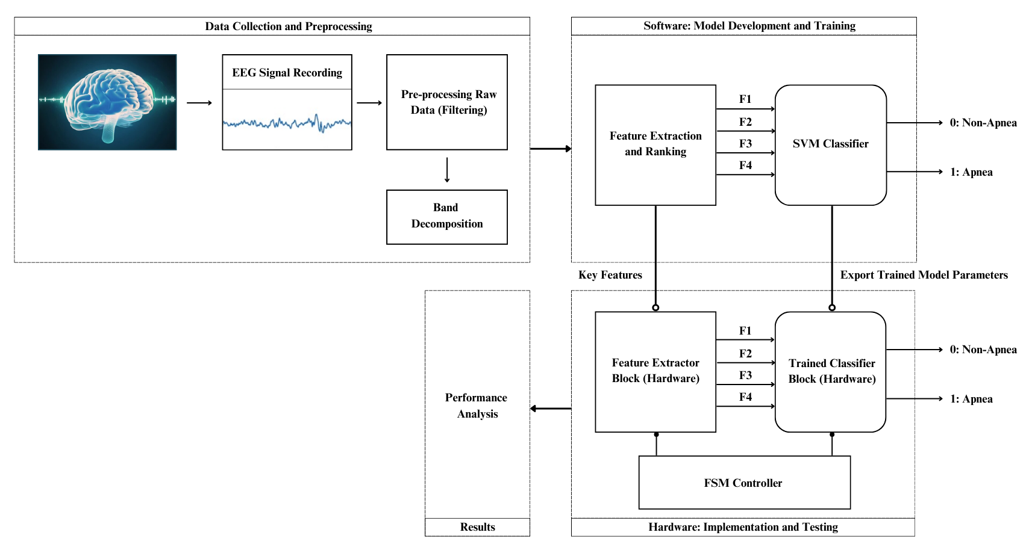
Overall Workflow

Slide 5
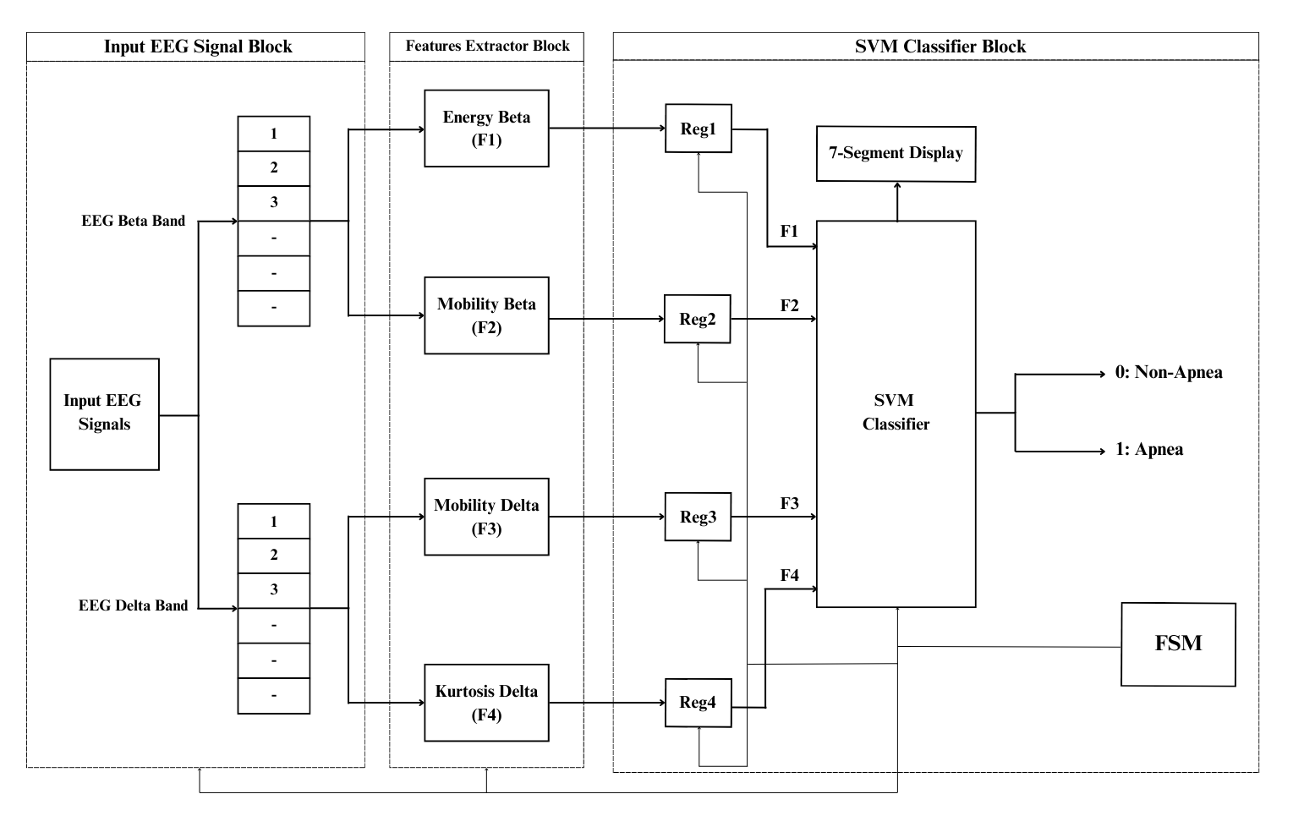
Hardware Implementation

Slide 6
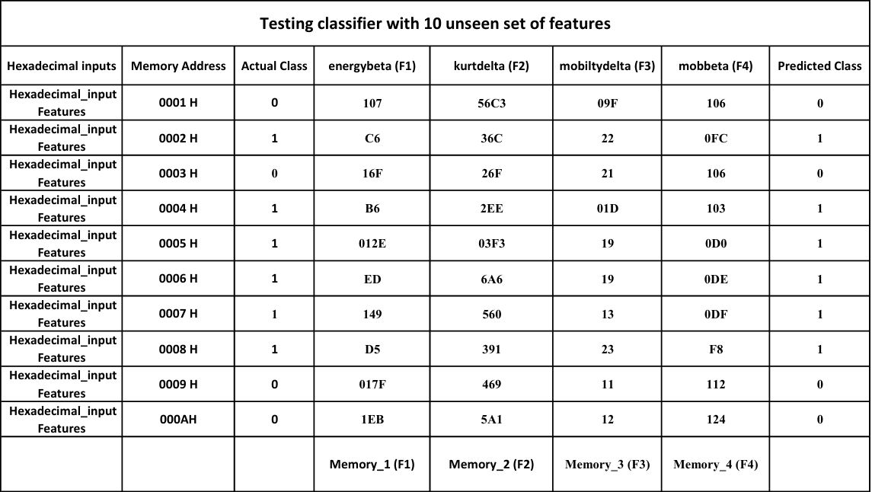
Datasheet for Final Demonstration

Slide 7
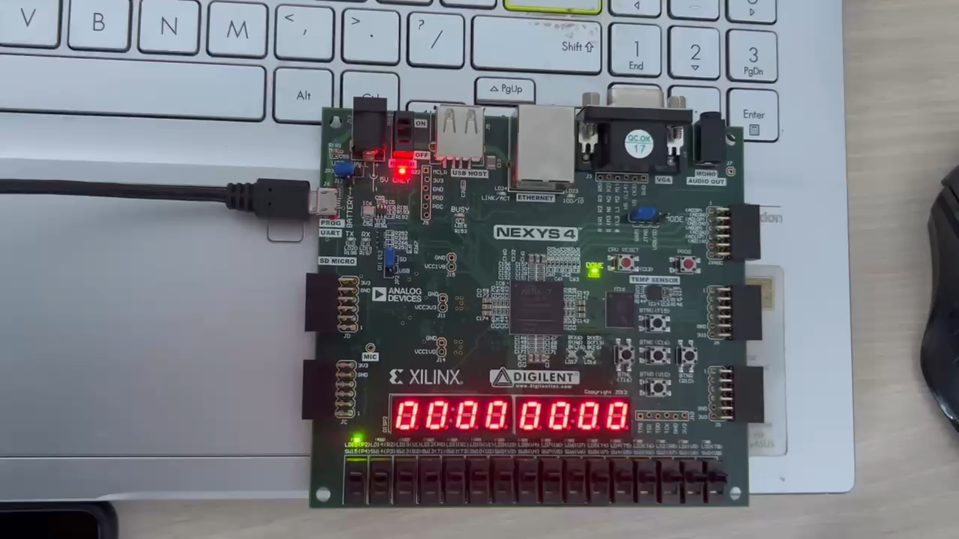
Live Demo

Slide 8
Experiment Results
Comparison of the proposed work using LSVM classifier with energy ratio-based features (E [1]), rician model-based features (R [2]) and ensemble bagged trees classifier based-model (B [3]).
Resource Utilization:
Sensitivity (%)
Specificity (%)
Accuracy (%)
E [1] | R[2] | B[3] | Proposed Software | FPGA
90.38 | 86.33 | 91.2 | 93.10 | 86.24
E [1] | R[2] | B[3] | Proposed Software | FPGA
94.03 | 90.25 | 96.6 | 96.43 | 96.2
E [1] | R[2] | B[3] | Proposed Software | FPGA
92.21 | 88.29 | 93.78 | 94.81 | 91.13
Resource | Utilizing | Available | % Utilization
LUT | 887 | 10400 | 8.53
FF | 942 | 20800 | 4.53
DSP | 9 | 45 | 20.00
IO | 93 | 106 | 87.74

Slide 9
Lessons Learned:
Adapting machine learning classifiers to FPGA hardware demonstrated the importance of scalability and efficiency in hardware-software co-design.
Insights were gained into exporting trained model parameters for seamless hardware integration.
Conclusion:
The system achieved high accuracy, sensitivity, and specificity, validating the effectiveness of the selected EEG features and LSVM classifier.
Potential expansions include exploring other biosignals (e.g., ECG) or more advanced classification algorithms for enhanced diagnostic capabilities.

Slide 10
References:
S. Saha, A. Bhattacharjee, and S. A. Fattah, ‘‘Automatic detection of sleep apnea events based on inter-band energy ratio obtained from multi-band EEG signal,’’ Healthcare Technol. Lett., vol. 6, no. 3, pp. 82–86, Jun. 2019.
A. Bhattacharjee, S. Saha, S. A. Fattah, W.-P. Zhu, and M. O. Ahmad, ‘‘Sleep apnea detection based on Rician modeling of feature variation in multiband EEG signal,’’ IEEE J. Biomed. Health Information, vol. 23, no. 3, pp. 1066–1074, May 2019.
R. Gupta, T. F. Zaidi, and O. Farooq, ‘‘Automatic detection of sleep apnea using sub-band features from EEG signals,’’ in Proc. 3rd Int. Conf. Signal Process. Inf. Secure (ICSPIS), Nov. 2020, pp. 1–4.
Dataset: https://physionet.org/content/ucddb/1.0.0/

Slide 11
Thank You

